Slide 1

Software Components of a DBMS
Presented by:
Aadarsh. B (192565009)
CSA0506 :Database Management Systems
Date: 18/07/2026
Technical Presentation

Slide 2
Introduction
A Database Management System (DBMS) is a complex software system that manages the storage, retrieval, and security of data. It consists of three primary functional layers:
Query Processor: The "Brain" that translates user requests into executable instructions.
Storage Manager: The "Body" that manages the physical interface between the DBMS and the OS file system.
Transaction Manager: The "Guarantor" that ensures data integrity and system reliability.

Slide 3
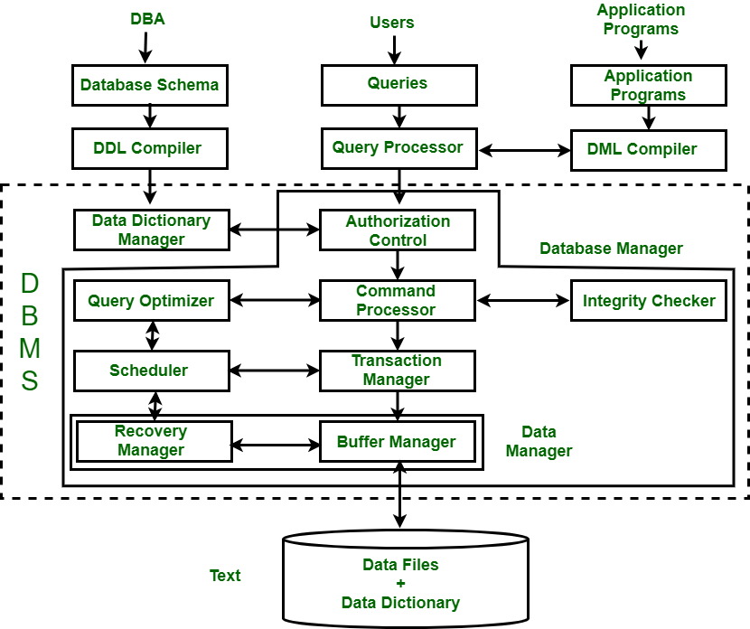
Core Technical Explanation
Bridging Users and Disk
The DBMS architecture provides a structured flow where user commands pass through layers of abstraction. This modularity allows for:
Independent optimization of storage and processing.
Scalability of individual components.
Enhanced security via centralized authorization controls.

Slide 4
Component I: The Query Processor
Query Processor: Overview & Roles
Key Roles:
Parsing: analyzing syntax.
Optimization: selecting a plan.
Execution: running the plan.
Main Objectives:
Minimize Response Time
Efficient Resource Usage
Correct Result Generation
High Throughput
The "Brain" of the DBMS
Crucial for Performance
Complex Query Handling
Plan Generation
Input: SQL Query
Output: Execution Plan
Interacts with Storage Mgr
Interacts with Transaction Mgr

Slide 5
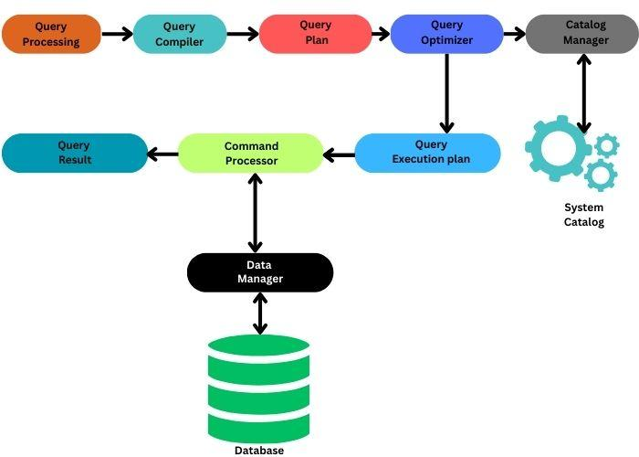
Query Processor Flow

Slide 6
Component II: The Storage Manager
Key Roles:
Buffer Management: RAM vs Disk.
File Organization: Data structures.
Indexing: B+ Trees and Hashing.
Main Objectives:
Optimize Disk I/O
Fast Data Retrieval
Space Efficiency
Physical Data Mapping
Interface with OS File System

Slide 7
Storage Manager: Deep Dive
Buffer Manager
Maintains a pool of data pages in RAM.
Reduces slow disk access.
Uses replacement policies (LRU).
Indexing
B+ Tree for range queries.
Hash maps for point lookups.
Clustered Indexing
Stores related data together.
Optimizes sequential scans.
Disk Management
Physical block allocation.
Managing free space.
Page layout management.
Dealing with fragmentation.
Ensuring data persistence.

Slide 8
Component III: The Transaction Manager
Role & Objectives:
Key Tasks:
- Concurrency Control
- Recovery Management
- Logging
- Deadlock Detection
- ACID Guarantee
ACID Properties:
Atomicity: All or nothing.
Consistency: Valid state.
Isolation: No interference.
Durability: Permanent save.

Slide 9
Transaction Manager: Deep Dive
Concurrency Control
Locks: Prevents multiple transactions from modifying same data.
Timestamping: Orders transactions by arrival time.
Two-Phase Locking (2PL): Ensures serializability.
Recovery Management
Log-based Recovery: Recording all changes to a log file.
Write-Ahead Logging (WAL): Log first, then database.
Checkpointing: Reducing recovery time by syncing to disk.
Undo/Redo: Restoring state after a crash.
Shadow Paging: Alternative to logging.

Slide 10
Interplay between Components
User Request (SQL) → Query Processor (Plan) → Transaction Manager (Locks) → Storage Manager (Data Access) → Physical Disk (I/O).
The synergy of these components ensures:
- Correctness (QP)
- Consistency (TM)
- Performance (SM)

Slide 11


Thank You!!!

